Slide 1
Getting started with Accelerated Reading
Using myON

Slide 2
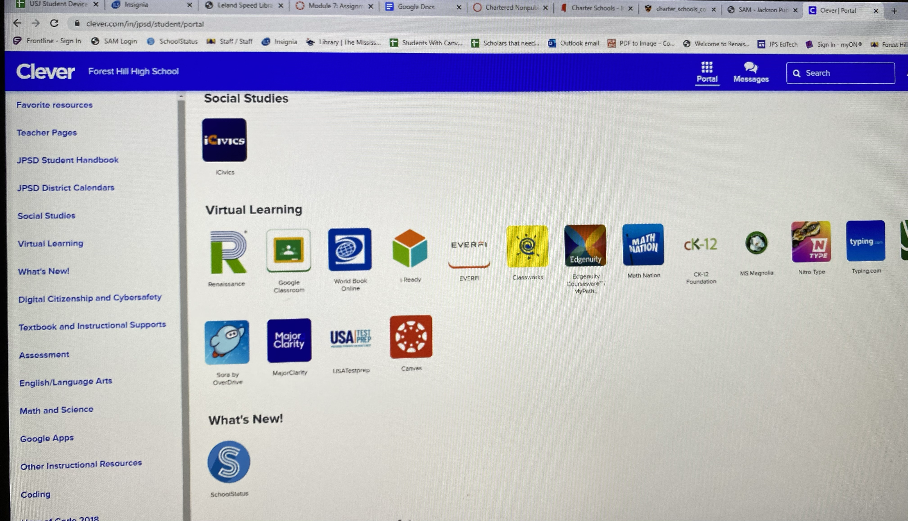
Step 1: Log into your Clever Account

Slide 3
Step 2: Click on the Renaissance App

Slide 4
ALMOST THERE!!
Step 3: Click on the “myON” tab.
Step 4: Click on the “Library” tab.

Slide 5
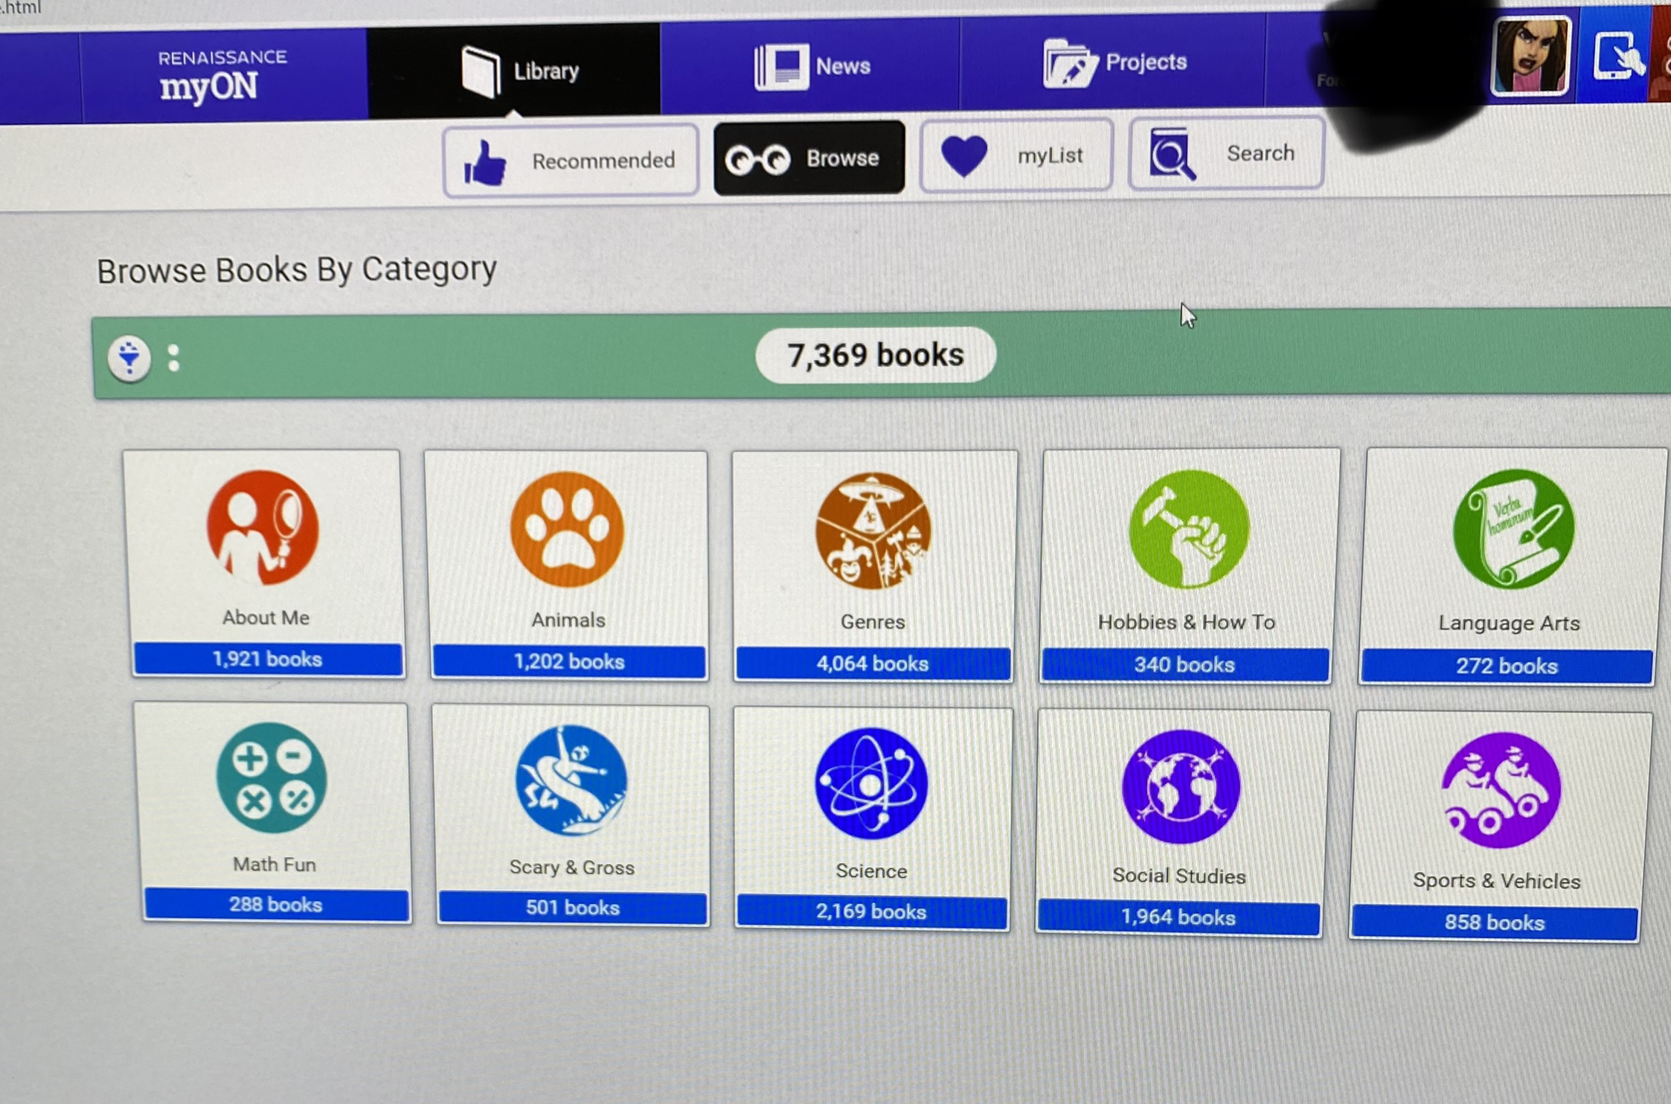
Browse or search for a book.
o
Click on “Browse” and choose a category.

Slide 6
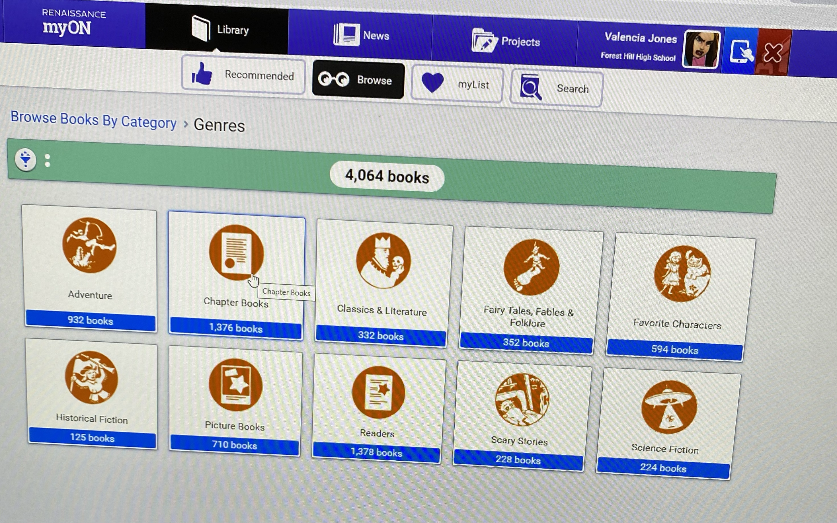
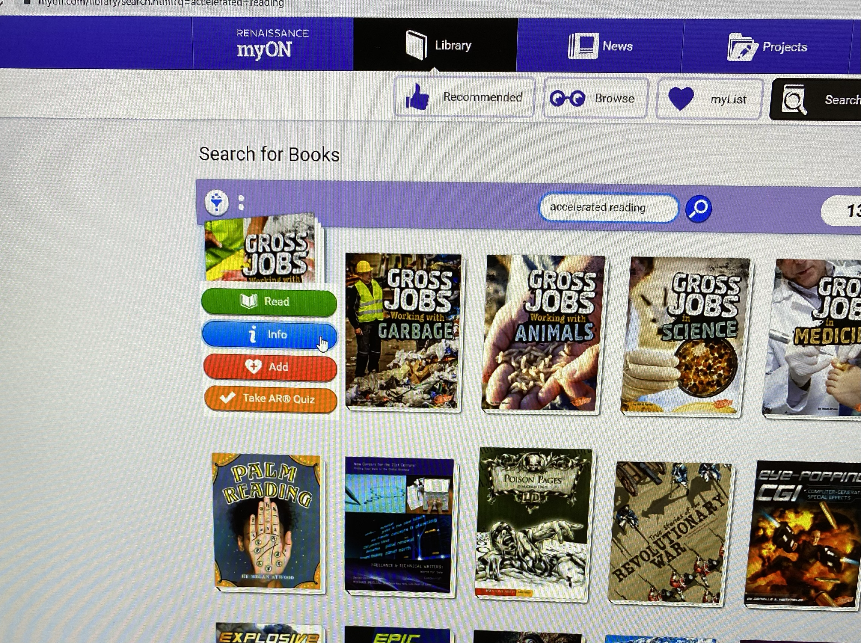
Choosing your book
Bright Idea Tip: Chapter books(located in the Genre category) have more points and will help you reach your goal.
goal.
Make sure the book you choose has an AR quiz

Slide 7
Choosing your books
Once you select the book that want to read, it will show you the book level, a summary of the story, and how many points the book is worth.
Choose your books wisely.
Click on the green tab to begin reading.
Click on “Take AR Quiz” tab when you are ready to take a quiz.

Slide 8
Large image slide
Now that you have all of the tools that you need, “LET’S GET TO READING”!!! THERE WILL BE A PIZZA PARTY FOR THE CLASS WITH 100% OF SCHOLARS REACHING OR EXCEEDING THEIR GOAL AS WELL AS AWARDS/ RECOGNITION FOR INDIVIDUAL SCHOLARS THAT REACH THEIR GOAL.
STILL NEED HELP?
COME SEE ME, MRS. HARPER IN RM. 242!!!
#PATRIOTNATION #LETSREAD #LETSREACHOURGOAL

